Slide 2
Securing Wireless & Mobile Solutions

Slide 3
Securing Wireless & Mobile Solutions
3.4 Given a scenario, install and configure wireless security settings
3.5 Given a scenario, implement secure mobile solutions

Slide 4
3.4 Given a scenario, install and configure wireless security settings
Authentication Methods
Authentication Protocols
Installation Considerations
Controller and Access Point Security

Slide 5
3.4 Given a scenario, install and configure wireless security settings
Authentication Methods
Open mode
No Credentials
No authentication
No security
Equivalent Privacy (WEP)
WEP RC4
Weakest form of wireless security, with a 40-bit key
Easy to crack within seconds by an Initialization Vector (IV) attack

Slide 6
3.4 Given a scenario, install and configure wireless security settings
Authentication Methods
Wi-Fi Protected Access (WPA)
WPA uses RC4-128 in TKIP
WPA replaced WEP as it uses the Temporal Key Integrity Protocol (TKIP)
Uses RC4 128 bit stream cipher
TKIP is vulnerable to replay attacks
WPS (Wi-Fi Protected Setup)
Non-credentialed Authentication
Password is already stored
Press push button to get connected to the wireless network
Commonly used to connect IoT

Slide 7
3.4 Given a scenario, install and configure wireless security settings
Authentication Methods
Wi-Fi Protected Access Version 2 (WPA2)
Much stronger than WPA
Uses Counter Mode with the Cipher Block Chaining Message Authentication Code Protocol (CCMP) also known as:
AES128_CCM
Features of WPA2 include:
WPA2- PSK (Pre-Shared Key)
WPA2-Enterprise
WPA2-WPS
WPA2-TKIP
WPA2-CCMP
WPA2-CCMP + TKIP

Slide 8




3.4 Given a scenario, install and configure wireless security settings
Authentication Methods
Pre-Shared Key (PSK)
User enters the password for home network access
Home version for WPA2 known as Personal Mode
WPA2-CCMP
Strongest version of WPA2
WPA2-TKIP
Provides compatibility with legacy systems
WPA2-CCMP + TKIP
Provides strong security for AES compatible systems
Provides compatibility with legacy systems
WPA2 Personal
Security Mode
PSK-mode
Authentication
TKIP and/or CCMP
Encryption
AES-128 (for CCMP)
RC4-128 (for TKIP)
Cipher/Algorithm

Slide 9
3.4 Given a scenario, install and configure wireless security settings
Authentication Methods
WPA2-Enterprise
Corporate version of WPA2
Centralized domain environment
AAA server combines with 802.1x
Uses server certificates for authentication
RADIUS - user management
TACACS+ - device management
802.1x uses EAP variant
WPA2 Enterprise
Security Mode
Enterprise-mode
802.1x using EAP
Authentication
CCMP
Encryption
AES-128 (for CCMP)
EAP-TLS
EAP-TTLS
Cipher/Algorithm
PEAP
EAP-FAST

Slide 10
3.4 Given a scenario, install and configure wireless security settings
Authentication Methods
Wi-Fi Protected Access Version 3 (WPA 3)
Released in 2018 to address the weaknesses in WPA2
Uses a much stronger 256-bit Galois/Counter Mode Protocol (GCMP-256) for encryption also known as:
AES256_GCM
Features of WPA3 include:
WPA3-SAE (Simultaneous Authentication of Equals)
WPA3-SAE Transition
WPA3-Enterprise
PMF (Protected Management Frames)
Wi-Fi Easy Connect
Wi-Fi Enhanced Open

Slide 11
3.4 Given a scenario, install and configure wireless security settings
Authentication Methods
Protected Management Frames (PMF)
WPA3 uses Protected Management Frames (PMF)
PMF Prevents attackers from capturing the encryption keys (IV Attack)
Wi-Fi Easy Connect:
Easy to connect IoT devices, such as a smartphone, by simply using a QR code
Wi-Fi Enhanced Open (OWE)
Enhancement of WPA2 open authentication
Uses encryption for open authentication
No password is required
Prevents eavesdropping as it uses PMF
Notes:
See the Student Resource Book for pictures of what the configurations look like.

Slide 12
3.4 Given a scenario, install and configure wireless security settings
Authentication Methods
Personal Mode
WPA3-SAE
Home version of WPA3 known as WPA3-Personal
Replaces the WPA2-PSK
Protects against brute-force attacks
Provides Perfect Forward Secrecy (PFS)
Ensures session keys cannot be compromised
Simpler passwords for home network access
Immune to offline attacks
WPA3-SAE Transition
Allows backwards compatibility with WPA2-PSK
WPA3-Personal
Security Mode
SAE-mode
Transition-mode
Authentication
CCMP
Encryption
AES-128 (for CCMP)
Cipher/Algorithm

Slide 13
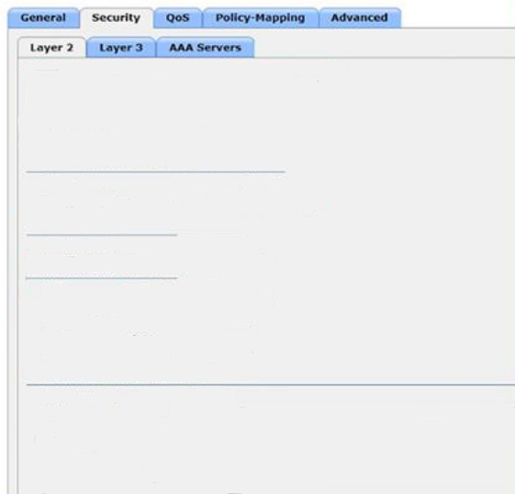



3.4 Given a scenario, install and configure wireless security settings
Authentication Methods
WPA3 SAE mode
Layer 2 Security: WPA2+WPA3
Security Type: Personal mode
Layer 2 Security
WPA2+WPA3
Security Type
Personal
MAC Filtering
WPA2+WPA3 PARAMETERS
Policy WPA3 + WPA2 Disabled = WPA3 SAE mode
Encryption Cipher: CCMP128(AES)
Also known as AES-128 in CCM
Policy
WPA2
WPA3
Encryption Cipher
CCMP128
FAST Transition
FAST Transition
Disabled
Protected Frame Management
PMF is Required
PMF
Required
Comeback timer(1-
10sec)
1
SA Query Timeout(100-
500msec)
200
Authentication Key Management
PSK Format
ASCII
P@$$w0rd12345
SAE
Enable
SAE is enabled by default
Notes:
I hide these four slides because these images are in the CompTIA Student book and they can see them there.

Slide 14
3.4 Given a scenario, install and configure wireless security settings
Authentication Methods
WPA3 Transition mode
Layer 2 Security: WPA2+WPA3
Security Type: Personal mode
Layer 2 Security
WPA2+WPA3
Security Type
Personal
MAC Filtering
WPA2+WPA3 PARAMETERS
Policy WPA3 + WPA2 Enabled = WPA3 Transition mode
Encryption Cipher: CCMP128(AES)
Also known as AES-128 in CCM
Policy
WPA2
WPA3
Encryption Cipher
CCMP128
FAST Transition
FAST Transition
Disabled
Protected Frame Management
PMF is configured as Optional; if configured as Required
WPA2 devices would not be able to connect
PMF
Optional
Comeback timer(1-
10sec)
1
SA Query Timeout(100-
500msec)
200
Authentication Key Management
PSK Format
ASCII
P@$$w0rd12345
PSK
Enable
All AKM’s can be configured based on PMF selection
SAE is enabled by default
PSK-SHA2
Enable
SAE
Enable

Slide 15
3.4 Given a scenario, install and configure wireless security settings
Authentication Methods
Enterprise Mode
Corporate version security mode
Centralized domain environment
AAA server combines with 802.1x
Uses AAA server certificates for authentication
RADIUS AAA Server - user management
TACACS+ AAA Server - device management
802.1x uses EAP variant
Enterprise Mode
Security Mode
Enterprise-mode
802.1x using EAP
Authentication
CCMP (for WPA2)
GCMP (for WPA3)
Encryption
AES-128 (for CCMP)
AES-256 (for GCMP)
EAP-TLS
EAP-TTLS
PEAP
EAP-FAST
Cipher/Algorithm

Slide 16
3.4 Given a scenario, install and configure wireless security settings
Authentication Methods
WPA2 Enterprise mode
Layer 2 Security: WPA2+WPA3
Security Type: Enterprise mode
Layer 2 Security
WPA2+WPA3
Security Type
Enterprise
MAC Filtering
WPA2+WPA3 PARAMETERS
Policy WPA3 + WPA2 Enabled
WPA2 Enterprise mode
Encryption Cipher: CCMP256
Policy
WPA2
WPA3
Encryption Cipher
CCMP128
CCMP256
GCMP128
GCMP256
FAST Transition
FAST Transition
Disabled
Protected Frame Management
PMF is Required
PMF
Not Required
Comeback timer(1-
10sec)
1
SA Query Timeout(100-
500msec)
200
Authentication Key Management
SUITEB192-1X
Enable
SUITEB128-bit Mode not offered by WPA2-Enterprise.

Slide 17
3.4 Given a scenario, install and configure wireless security settings
Authentication Methods
WPA3 Enterprise mode
Layer 2 Security: WPA2+WPA3
Security Type: Enterprise mode
Layer 2 Security
WPA2+WPA3
Security Type
Enterprise
MAC Filtering
WPA2+WPA3 PARAMETERS
Policy WPA3 + WPA2 Enabled
WPA3 Enterprise mode
Encryption Cipher: GCMP256
Policy
WPA2
WPA3
Encryption Cipher
CCMP128
CCMP256
GCMP128
GCMP256
FAST Transition
FAST Transition
Disabled
Protected Frame Management
PMF is Required
PMF
Required
Comeback timer(1-
10sec)
1
SA Query Timeout(100-
500msec)
200
SUITEB192-bit Mode offered by WPA3-Enterprise.
When used PMF shall be set to required
SUITEB192-bitlevel security.
TLS_ECDHE_RSA_WITH_AES_256_GCM_SHA384
TLS_ECDHE_ECDSA_WITH_AES_256_GCM_SHA384
Authentication Key Management
SUITEB192-1X
Enable

Slide 18
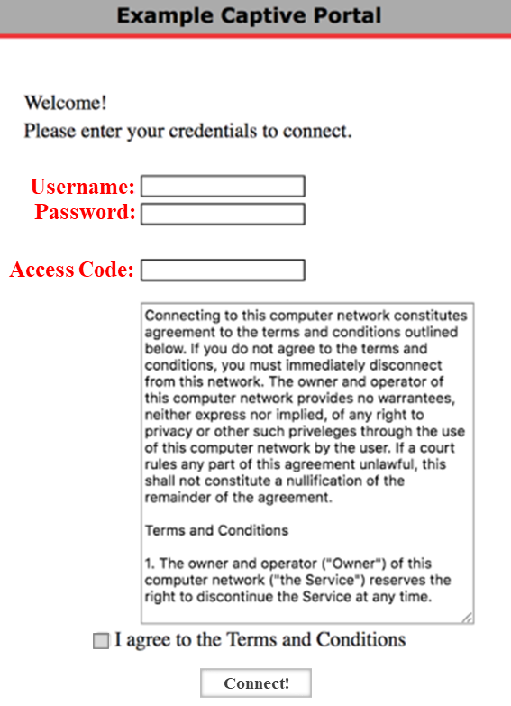
3.4 Given a scenario, install and configure wireless security settings
Authentication Methods
Captive Portal
Basic accountability for access to the public network
Allows guests to use an "open" WiFi network
Background reconnection for mobile users
Visitors accepts the AUP or terms of service

Slide 19
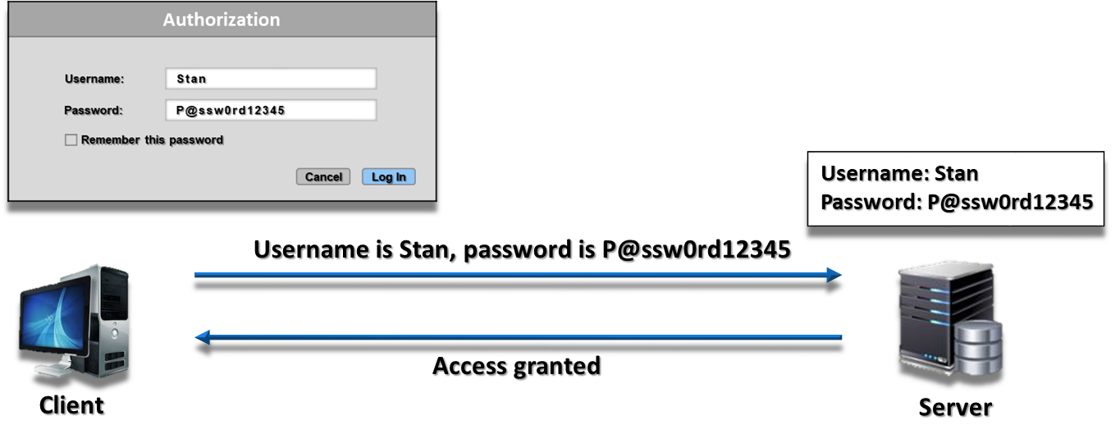
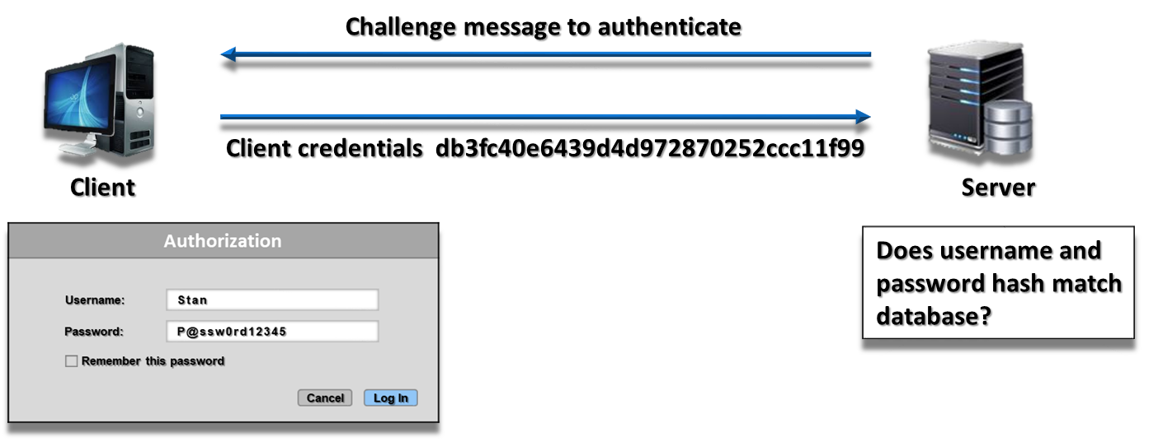
3.4 Given a scenario, install and configure wireless security settings
Authentication Protocols
PPP (Point-to-Point Protocol)
Used when authentication needs to be sent across these networks.
PAP (Password Authentication Protocol)
Passwords are transmitted as clear text and can be easily captured.
2-way handshake
CHAP/MSCHAP (Microsoft Challenge Handshake Authentication Protocol)
Uses a challenge-response mechanism with password encryption
Client send cryptographic function of the password (password hash)
PAP
CHAP

Slide 20

Introduction to the Point-to-Point Protocols
Notes:
Introduction to the Point-to-Point Protocols
https://www.youtube.com/watch?v=7PtTn38f4os
See also:
The three phases of PPP including PAP and CHAP
https://www.youtube.com/watch?v=hneSiV0N-hM
This is a very good video, and she’s got all her facts right, but she makes one big mistake at the very end. Hashes are compared, they cannot be decrypted. Hashes are one-way functions.
Here is what is on the summary slide in the first video:
PPP operates at layer 2 of the OSI model
Purpose: transport layer 3 protocols over serial links
Made up of LCP and NCP
LCP
Link establishment
Authentication
Error detection
Multilink
Load balancing
NCP
How to transmit the layer 3 protocols

Slide 21
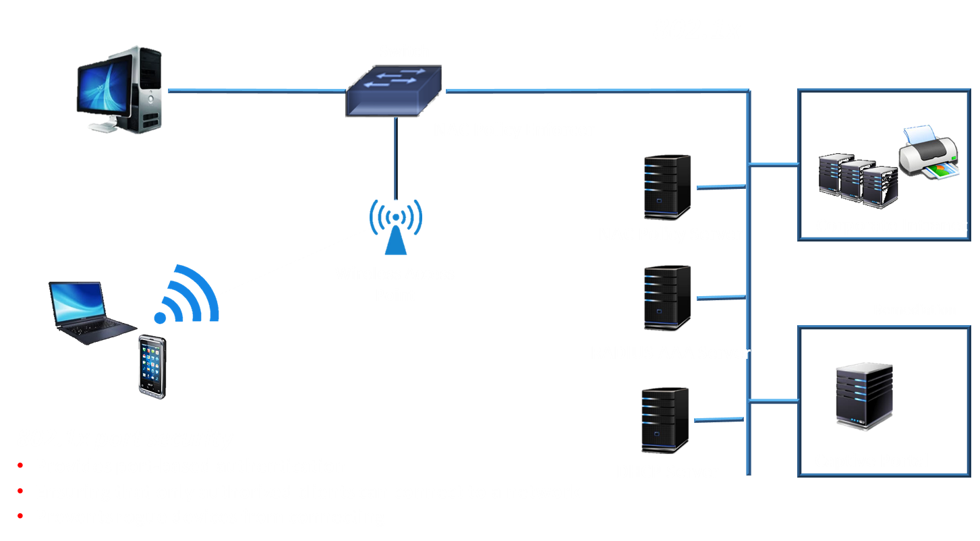
802.1x Port Security
21

Slide 22
3.4 Given a scenario, install and configure wireless security settings
Authentication Protocols
IEEE 802.1x
Standard for Port-Based Network Access Control (PNAC)
Provides protected authentication for secure wired and wireless networks
Switch (LAN)
Access Point (Wireless)
Wireless LAN Controller (WLC)
Ensures access is granted only after a user or device has been authenticated
EAPoL (EAP over LAN)
EAPoW (EAP over Wireless)
Authentication Server
RADIUS
TACACS+

Slide 23
3.4 Given a scenario, install and configure wireless security settings
Authentication Protocols
Extensible Authentication Protocol (EAP)
Authentication framework allowing point-to-point connections
Commonly used with wireless communication
EAP TLS
PEAP (Protected Extensible Authentication Protocol)
EAP-TTLS
EAP-FAST (Flexible Authentication via Secure Tunneling)
Cisco proprietary. Replaced LEAP.
Server generates a key and provides it to trusted clients
Does not use certificates but can support the use of them

Slide 24
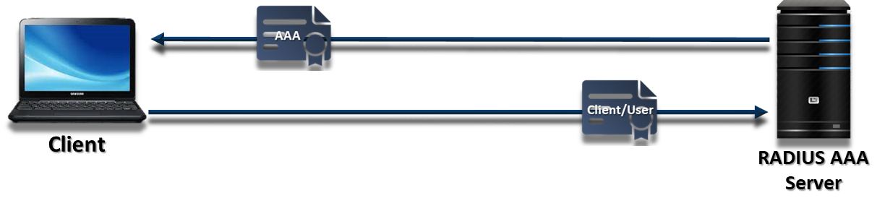
3.4 Given a scenario, install and configure wireless security settings
Authentication Protocols
EAP-TLS (EAP over Transport Layer Security)
Most secure (compared to other EAP methods)
No user intervention
Needs X.509 certificates installed on the endpoints for mutual authentication
Requires certificate on the clients
Requires certificate on 802.1x server

Slide 25
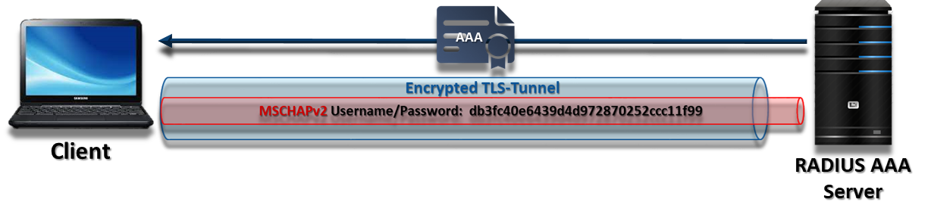
3.4 Given a scenario, install and configure wireless security settings
Authentication Protocols
PEAP (Protected EAP)
Encapsulated the EAP data and made it more secure for WLANS
Accomplishes this by using tunneling between PEAP clients and an authentication server
Provides mutual authentication
Requires certificate on 802.1x server
Supports client usernames and EAP-based password inner authentication methods passwords
EAP-MSCHAPv2 (PEAPv0)
EAP-GTC (PEAPv1)
Client sends encrypted username and password hash to identify itself
Username password hash protected by encrypted TLS tunnel
Client Authenticated by the Radius AAA Server

Slide 26
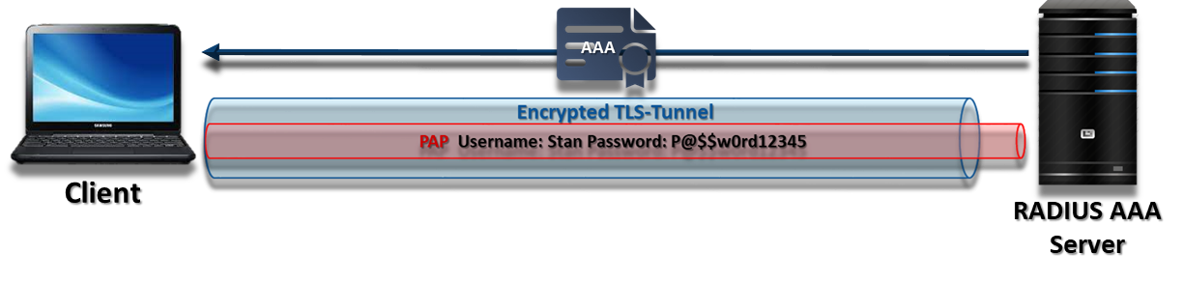
3.4 Given a scenario, install and configure wireless security settings
Authentication Protocols
EAP-TTLS (EAP over Transport Layer Security)
Client authenticates RADIUS AAA Server certificate
Creates a tunnel for the users' credentials to travel through.
Secures older authentication methods like Password Authentication Protocol
EAP-TTLS/PAP
Client sends Clear text username and password to identify itself
Username and password protected by encrypted TLS tunnel
Client Authenticated by the Radius AAA Server

Slide 27
3.4 Given a scenario, install and configure wireless security settings
Authentication Protocols
RADIUS (Remote Authentication Dial-In User Service)
Determines user identity by communicating with the organization’s directory, typically over the LDAP or SAML protocol
Provide authentication, authorization, and accounting in one service
UDP 1812 - Authentication and Authorization
UDP 1813 - Accounting
Centrally managed authentication
User Access control
RADIUS Federation
Use RADIUS with federation
Members of one organization can authenticate to the network of another organization
Use their normal credentials
Diameter
AAA Server that is a more modern version of RADIUS that works on TCP

Slide 28
3.4 Given a scenario, install and configure wireless security settings
Authentication Protocols
TACACS+ (Terminal Access Controller Access-Control System Plus)
Provide Separate control of each service: authentication, authorization, and accounting
TCP 49
Centrally managed authentication
Device access management
Used to control specific commands that can be executed on a network infrastructure device
Network infrastructure device such as VOIP Services

Slide 29




3.4 Given a scenario, install and configure wireless security settings
Authentication Protocols
IEEE 802.1x
Supplicant
802.1x
Authenticator
RADIUS
Authentication
Server
EAPoL- EAPoW
EAPoR
Client/User
Switch/Access Point/WLC
AAA Server IP:
Shared Secret:
Auth Port:
Acct Port:
RADIUS/TACACS+
Client IP:
Shared Secret:
ESSID:
Network Auth:
Data Encryption:
ESSID:
Network Auth:
Data Encryption:
EAP Types
EAP Types

Slide 30
3.4 Given a scenario, install and configure wireless security settings
Installation Considerations
Site Survey
Identify what could cause interference with the wireless network
Determine intermittent connectivity
WAP Placement
There are many things that could interfere with or prevent your wireless network from working
Load-bearing walls
Cordless phones
Microwaves
Elevators
Metal frames
Metal doors
Radio waves

Slide 31
3.4 Given a scenario, install and configure wireless security settings
Installation Considerations
Heat Map
A heat map shows your wireless coverage
Red and orange areas indicate good coverage
Blue areas indicate poor coverage

Slide 32
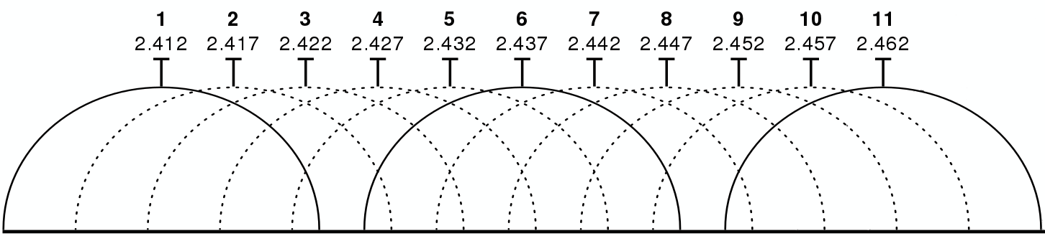
3.4 Given a scenario, install and configure wireless security settings
Installation Considerations
Recommended channels to use on 2.4Ghz are Channel 1, 6 & 11.
Channels do not overlap into each other
Channel 1: Your first wireless device (router)
Channel 11: Your second wireless device
Channel 6: Your third wireless device
5 GHz, it is recommended to use at least 40 MHz channel width
Do you know what a “thin” access point is?
Notes:
Fat AP - Standalone WAP, similar to that used at home
Thin AP - Used to manage multiple APs remotely

Slide 33
3.4 Given a scenario, install and configure wireless security settings
Installation Considerations
Wireless Standards
Mixed mode allows backwards compatibility with standards and devices
IEEE Standard | Frequency Band | Maximum Allowable Streams
802.11a | 5 GHz | 1
802.11b | 2.4 GHz | 1
802.11g | 2.4 GHz | 1
802.11n | 2.4 GHz and 5 GHz | 4
802.11ac | 5 GHz | 8
802.11ax | 2.4 GHz and 5 GHz | 16

Slide 34
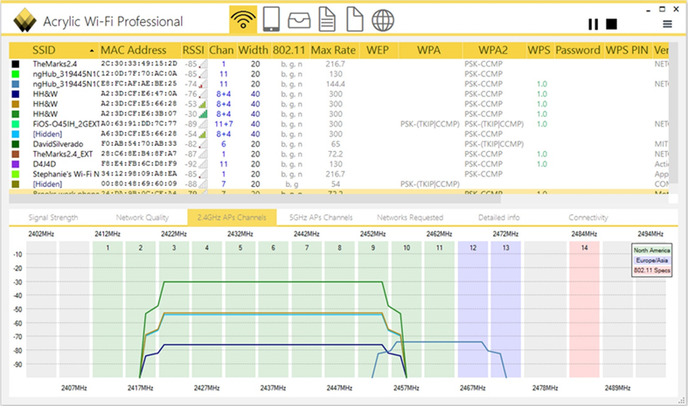
3.4 Given a scenario, install and configure wireless security settings
Controller and Access Point Security
WiFi Analyzer can be used to detect receive signal strength and uncloak a disabled SSIDs

Slide 35
3.4 Given a scenario, install and configure wireless security settings
Controller and Access Point Security
Default Username and Password
Change default username and password and configure admin password (master password)
Disable the Security Set Identifier (SSID)
Protect the wireless network by disabling the SSID so that it is not broadcast
MAC Filtering
Only those devices with a MAC address listed will be allowed access

Slide 36
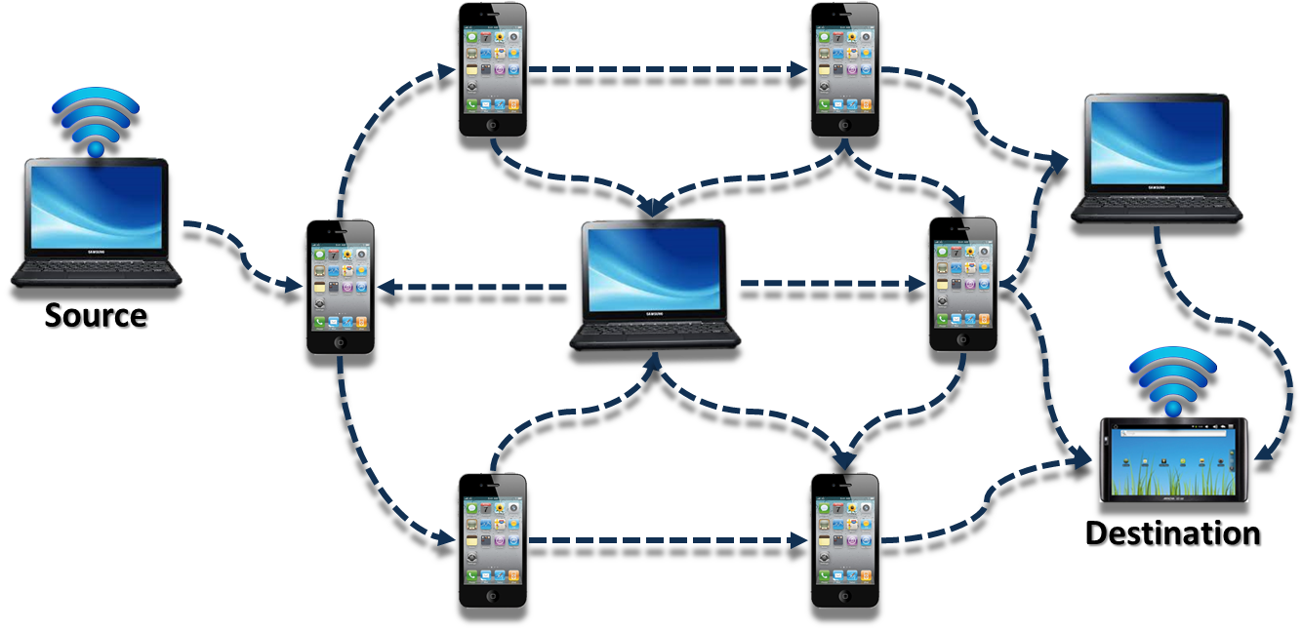
3.5 Given a scenario, implement secure mobile solutions
Connection Methods and Receivers
Tethering
NFC/RFID
Bluetooth / Personal Area Network (PAN)
SATCOM
Wi-Fi Direct/Ad Hoc
Allows two Wi-Fi devices to connect without requiring a WAP
Mobile device management (MDM)
Enforcement and Monitoring
Deployment Models
Do you know what “sideloading” is?
Do you know what Blueborne is?
Notes:
Bluetooth
Devices have a range of about 10 meters
The devices are paired using a code to connect
provide a personal area connection (PAN)
Secure Satellite Communications (SATCOM)
Dish at one location that connects point to point with a dish in another location

Slide 37
3.5 Given a scenario, implement secure mobile solutions
Mobile Device Management (MDM)
Management console that allows security administrators to control, secure, and enforce policies on mobile devices
Mobile Devices
Smartphones
Tablets
Other endpoint devices (UEM)
Download Manager
Controls the number of connections
Speed of downloading onto a mobile device
Mobile Application Management (MAM)
Uses whitelists for authorized applications
Ability to install mobile tools
Content Management
Prevents confidential or business data from being shared with external users
Containerization
Policies
Remote wipe capabilities (Containerization)
Geolocation services
Patch management and reporting
Mandatory screen locks
Ability to require passcodes and pins
Ability to require encryption
Mobile device OSs must be patched up to the latest release (Posturing)
Ability to prevent the use of camera & microphone

Slide 38
3.5 Given a scenario, implement secure mobile solutions
Mobile Device Management (MDM)
Context-Aware Authentication
Location-based and situational
Combine multiple contexts
Where you normally login (IP address
Where you normally frequent (GPS information
Anti-virus and security posture status
Context-aware security, example:
Allow authentication from within the United States anytime
Allow authentication if the user is accessing email or a shared file system
Do not allow authentication if the AV program is two days out of date
Do not allow authentication if the location is outside of the country

Slide 39
3.5 Given a scenario, implement secure mobile solutions
Deployment models
BYOD (bring your own device)
Employees are able to bring personally owned devices into a corporate computing environment
Does not necessarily prevent the transfer of corporate information to the device
There is no standardization
Employees do not replace their devices often enough to keep them running efficiently
The company does not have enough control over the devices
Require applications to be digitally signed to decrease the risk of users jailbreaking mobile devices
Containerization of company data
CYOD (choose your own device)
Employee is permitted to choose from a selection of approved devices
The company owns the device
Standardized deployment
Allows employees to make personal use of devices

Slide 40
3.5 Given a scenario, implement secure mobile solutions
Deployment models
COBO (Corporate-Owned Business Only)
Organization purchases devices and issues them to employees
Devices are heavily restricted and only used for work
Most secure, but rigidity impacts productivity
COPE (corporate-owned, personally enabled)
The company owns the device
Standardized deployment
Employee does not necessarily have the ability to choose the device
Allows employees to make personal use of corporate-owned devices
Limited choice of devices
Much easier to support than BYOD

Slide 41

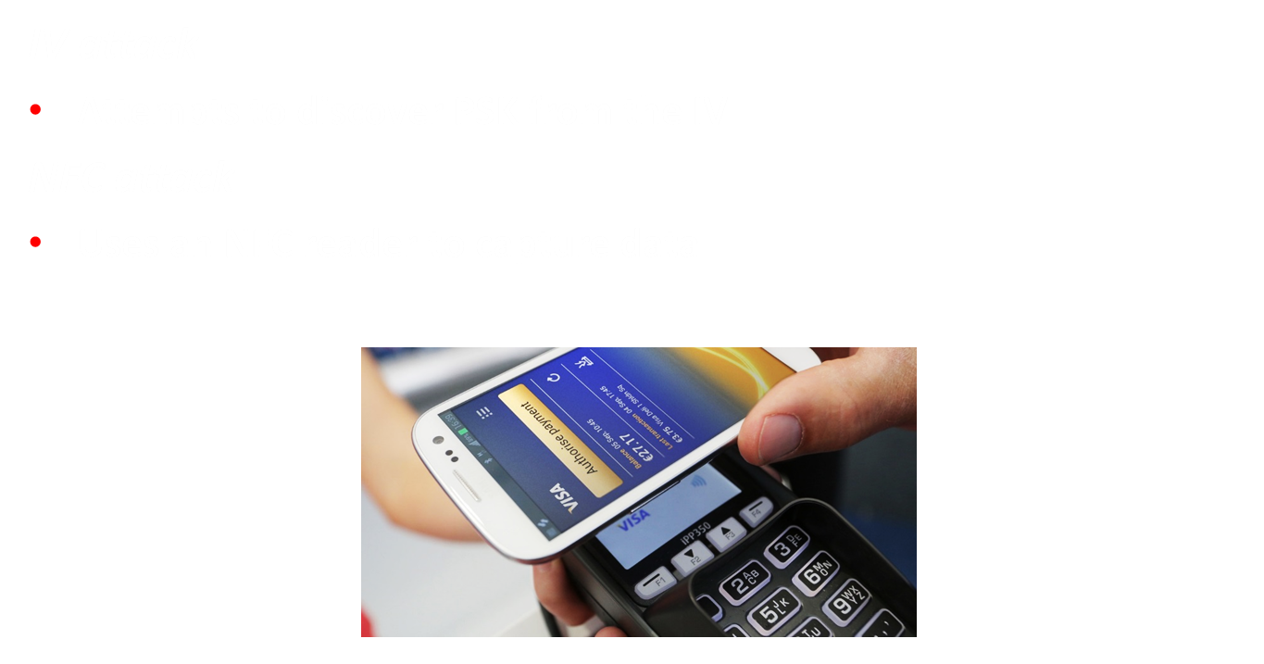
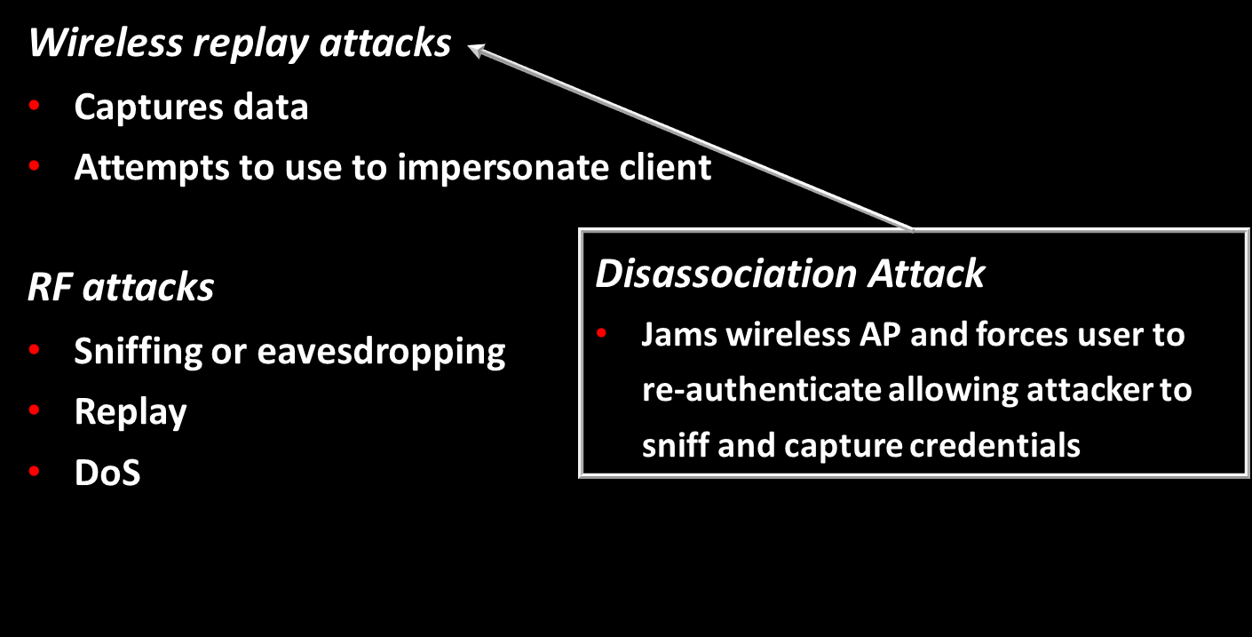
Mobile / Wireless Attacks

Slide 42
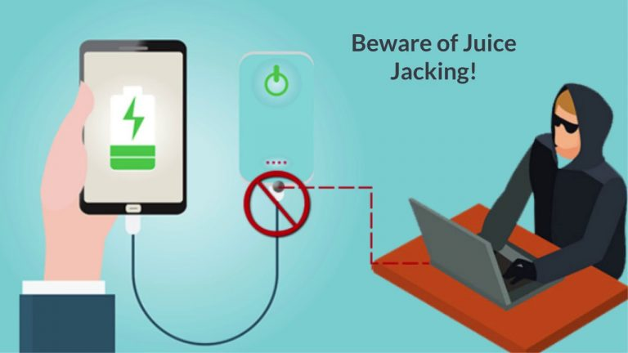
Rogue Access Points and Evil Twins
Rogue access point
Troubleshooting access point misconfiguration
Disable unused devices and interfaces
Evil twin
Masquerade as legitimate AP
Use similar SSID
Capture authentication information

Slide 43
Answer the questions…
A security administrator has been using EAP-FAST wireless authentication since the migration from WEP to WPA2. The company’s network team now needs to support additional authentication protocols inside of an encrypted tunnel. Which of the following would meet the network team’s requirements?
EAP-TLS
PEAP
EAP-TTLS
EAP-MSCHAPv2
A system administrator has configured MAC filtering on the corporate access point, but access logs show that unauthorized users are accessing the network. The administrator has confirmed that the address filter includes only authorized MAC addresses. Which of the following should the administrator configure to prevent this authorized use?
Enable WPA3 encryption
Remove unauthorized MAC addresses from the filter
Modify the SSID name
Modify the channel
A security administrator would like use employee-owned cell phones to unlock the door of the data center using a sensor on the wall. The users would authenticate on their phones with a fingerprint before the door would unlock. Which of the following features should the administrator use? (Select TWO)
NFC
Remote Wipe
Containerization
Biometrics
Push notification
Notes:
Answers:
C. EAP-TTLS (EAP-TTLS (Extensible Authentication Protocol - Tunneled Transport Layer Security) allows the use of multiple authentication protocols transported inside of an encrypted TLS (Transport Layer Security) tunnel. This allows the use of any authentication while maintaining confidentiality with TLS.
2. A. Enable WPA3 encryption
A MAC (Media Access Control) address can be spoofed on a remote device, which means anyone within the vicinity of the access point can view legitimate MAC addresses and spoof them to avoid the MAC filter. To ensure proper authentication, the system administrator can enable
WPA3 (Wi-Fi Protected Access version 3) with a shared key, or configure 802.1X to integrate with an existing authentication database.
The incorrect answers:
B. Remove unauthorized MAC addresses from the filter - Since MAC addresses are visible when capturing packets, any unauthorized users affected by the removal of a MAC address would simply obtain the remaining MAC addresses in use and spoof those addresses to gain access.
C. Modify the SSID name - The SSID (Service Set Identifier) is the name associated with the wireless network. The name of the access point is not a security feature, so changing the name would not provide any additional access control.
D. Modify the channel - The frequencies used by the access point are chosen to minimize interference with nearby wireless devices. These wireless channels are not security features and changing the frequency would not limit unauthorized access.
3. The Answer: A. NFC and D. Biometrics
The wall sensor will be activated with the phone’s NFC (Near-field Communication) electronics and would authenticate using the biometric
fingerprint reader on the phone.
The incorrect answers:
B. Remote wipe - Although remote wipe can be a useful management tool for a mobile device, there’s no need to include remote wipe capabilities with this particular application. The door unlocking process would still require authentication using the user’s fingerprint if the phone was lost or stolen.
C. Containerization - This application doesn’t appear to store any confidential local data, so keeping the enterprise data separate from the personal data isn’t a significant concern.
E. Push notification - A push notification will cause alerts to appear on the phone without any user intervention. In this app, all the actions are initiated by the user.

Slide 44

Questions?

Slide 45
8. Securing Wireless & Mobile Solutions
3.4 Given a scenario, install and configure wireless security settings
3.5 Given a scenario, implement secure mobile solutions

